Slide 1
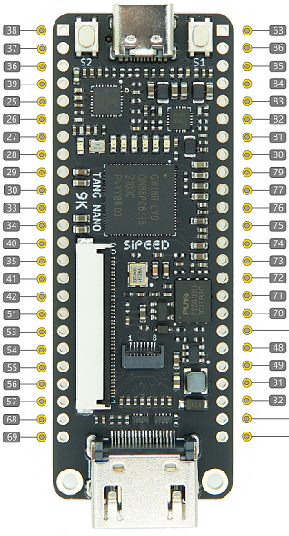
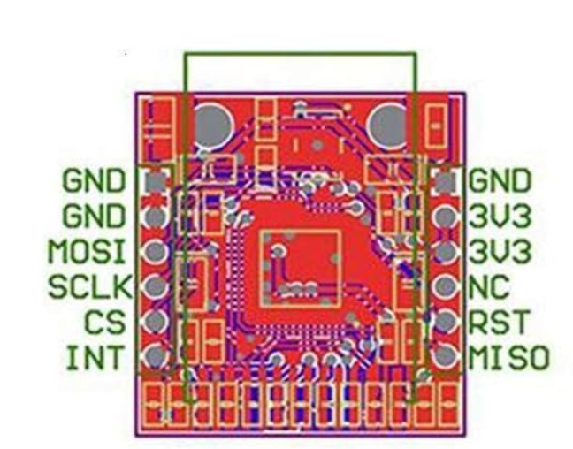
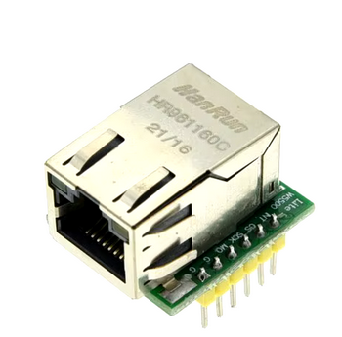

Slide 2
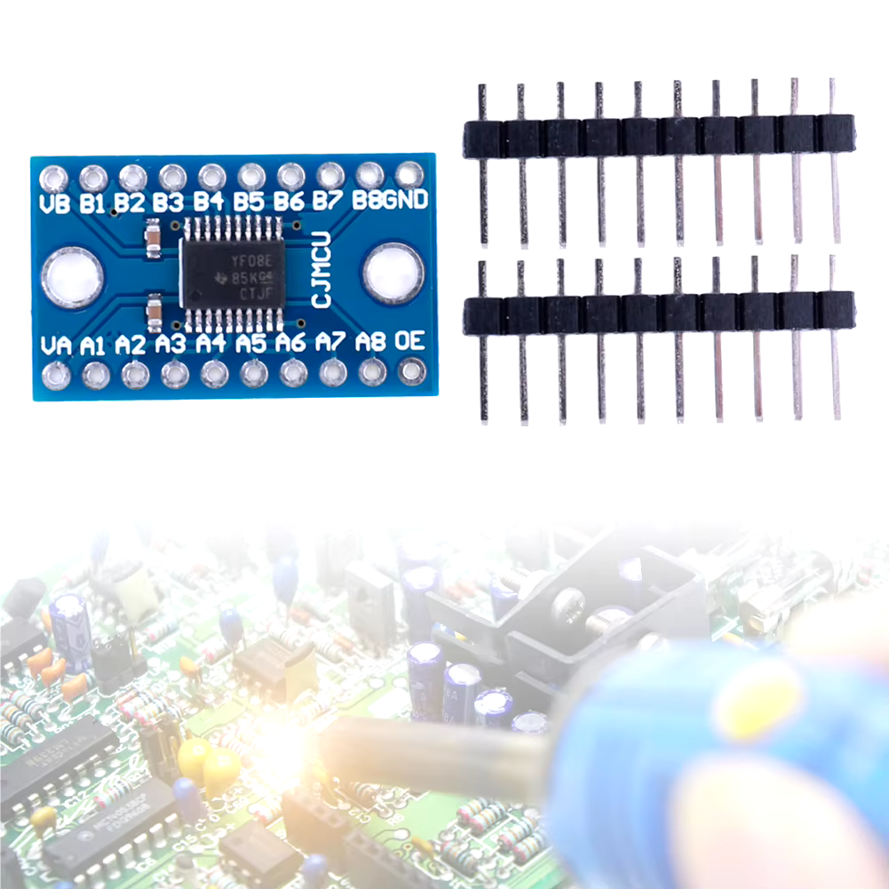
Joint 1 and 2
5V
Out J1 Step
Out J1 Dir
Out J1 En
In J1 Home
Out J2 Step
Out J2 Dir
Out J2 En
In J2 Home
GND
Joint 1 and 2 I/O
27
28
29
30
33
34
40
35

Slide 3

Joint 1 and 2
5V
Out J1 Step
Out J1 Dir
Out J1 En
In J1 Home
Out J2 Step
Out J2 Dir
Out J2 En
In J2 Home
GND
Joint 1 and 2 I/O
27
28
29
30
33
34
40
35
Source https://www.raspberrypi.com/documentation/computers/raspberry-pi.html
https://wiki.sipeed.com/hardware/en/tang/Tang-Nano-9K/Nano-9K.html

